Slide 1
Anomaly Localisation and Root Cause Identification in Multivariate Industrial Sensor Time-Series Data
Syeda Tamanna Sheme
MIT251762
MR603 Thesis 1 | Confirmation of Candidature
Cluster Lead: Dr Nisha Kumari | Supervisor: Dr Abdussalam Ali
Notes:
[~15 sec] Good morning. My name is Syeda Tamanna Sheme, and my research is on anomaly localisation and root-cause identification in multivariate industrial sensor data. In simple words: when something goes wrong in a system with many sensors, how do we find where the problem actually started?

Slide 2
Introduction and Research Context
Why anomaly detection alone is not enough
Modern industrial systems rely on many connected sensors. By continuously monitoring sensor data, abnormal behaviour can be detected early, helping with fault detection and predictive maintenance.
1
2
3
DETECT
LOCALISE
IDENTIFY SOURCE
Something is abnormal
Which variables are involved?
Where did it begin?
CORE PROBLEM
The highest anomaly score may belong to a downstream symptom, not the component that initiated the disturbance.
Sources: [1]-[3], [9]-[12]
Notes:
[~1 min] Modern industrial systems use many connected sensors, and anomaly detection can tell us early that something is wrong.
But there are three different questions here. First, detection: is something abnormal? Second, localisation: which variables are involved? Third, root-cause identification: where did it begin?
My research focuses on the third question. The core problem is that the variable with the highest anomaly score may only be a downstream symptom, not the component that actually started the disturbance.

Slide 3
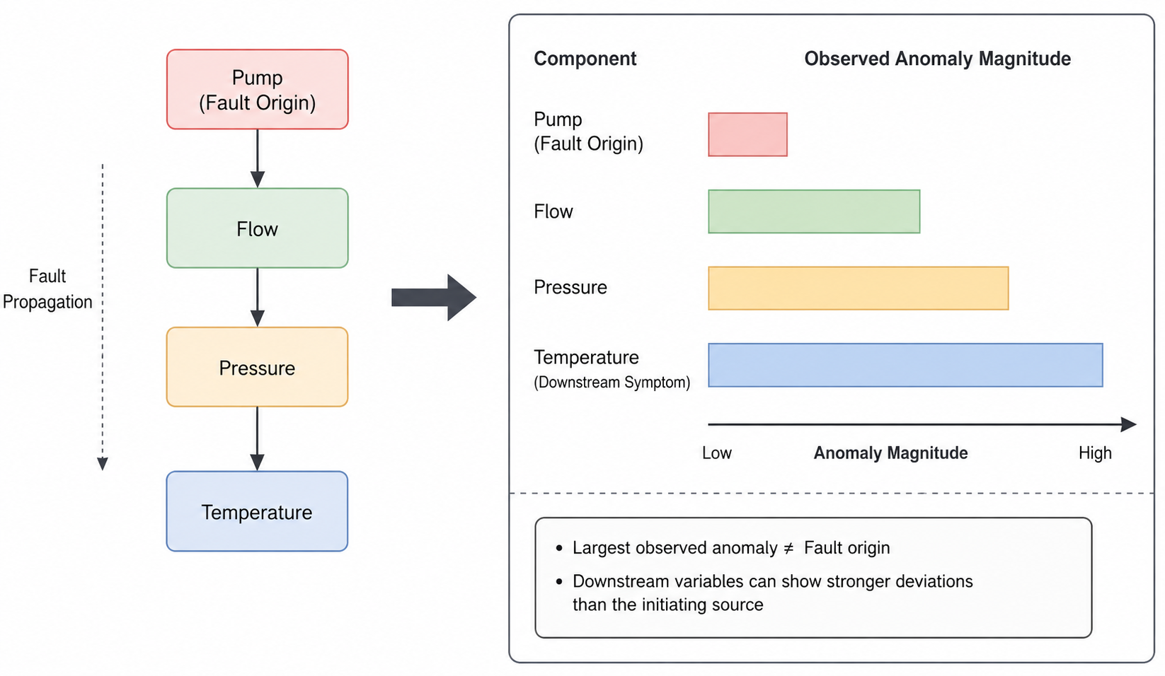
Problem Domain
Source vs. symptom in a multivariate sensor system
Anomaly localisation
Which variables are affected?
Root-cause identification
Which variable or component initiated the disturbance?
Figure 1. Fault propagation from source to downstream symptoms
Largest anomaly is not always the fault origin
Sources: [1], [2], [4], [5], [9]-[12]
Notes:
[~1 min] Here is a simple example. A fault starts at the pump. It then affects flow, then pressure, then temperature.
All four sensors end up looking abnormal, but only the pump is the true source. And because the effect grows as it travels, temperature can show the biggest change.
So if we simply blame the most abnormal sensor, we pick temperature, which is the wrong answer. The largest anomaly is not always the fault origin. This is what I call the source-versus-symptom problem.

Slide 4
Research Questions and Objectives
What the study sets out to answer
Can existing localisation and causal RCA methods distinguish the initiating source from downstream propagated effects?
RESEARCH OBJECTIVES
RQ1
O1
Compare representative baselines
O2
Quantify source-symptom confusion
Which timing, dependency, causal and counterfactual signals best separate the source from symptoms?
RQ2
O3
Test robustness and evidence
O4
Separate detection / localisation / RCA metrics
If a clear gap is found, can the most reliable evidence improve root-cause ranking?
RQ3
O5
Develop a new method only if justified
Sources: derived from Sections 2.5-2.6 of the report
Notes:
[~1 min] From this problem, I have three research questions.
RQ1: can existing localisation and causal methods tell the true source apart from downstream effects?
RQ2: which kinds of evidence, such as timing, relationships, causal structure, propagation or counterfactuals, stay reliable under difficult conditions?
RQ3: only if a clear gap is found, can the most reliable evidence improve root-cause ranking?
The five objectives on the right are my concrete plan. Objective 5, building a new method, is conditional on the evidence.

Slide 5
Literature Review Summary 1/2
Detection-oriented families: what they offer and where they stop
Reconstruction / probabilistic
Graph / dependency
Transformer-based
OmniAnomaly, MSCRED, DAGMM, USAD, THOC
GDN, MTAD-GAT, InterFusion, DAEMON
Anomaly Transformer, ALoRa-Loc, SARAD, TranAD
STRENGTH
STRENGTH
STRENGTH
Excellent detection and interpretation
Models inter-variable structure
Long-range temporal and cross-variable modelling
LIMITATION
LIMITATION
LIMITATION
Not designed to separate source from symptom
Dependency does not prove causality
Still infers the source from learned relations
[1], [4], [17]-[20]
[2], [5], [6], [21]-[23]
[3], [7], [8], [24]-[29]
Shared weakness: their rankings mainly reflect statistical abnormality, not causal origin.
Sources: [1]-[8], [17]-[29]
Notes:
[~50 sec] Now the literature. I grouped existing methods into families.
Reconstruction and probabilistic methods, such as OmniAnomaly, are very good at detection, but they are not designed to separate source from symptom.
Graph and dependency methods, such as GDN, model how sensors relate, but a learned dependency does not prove causality.
Transformer methods, such as ALoRa-Loc, capture long-range patterns, but they still infer the source from learned relations.
The shared weakness: their rankings reflect how abnormal a variable looks, not where the fault started.

Slide 6
Literature Review Summary 2/2
Causal methods, evaluation research and key papers compared
Causal / counterfactual RCA
Evaluation research
Results depend on dataset and metric, so each level should be reported separately.
CIRCA, RCD, AERCA, EasyRCA, CORAL, Conditional Attribution
[13]-[16]
STRENGTH
Method | Strength | Remaining concern
OmniAnomaly [1] | Probabilistic detection with per-variable scores | Source attribution is not its main goal
GDN [2] | Learns sensor dependencies | Dependency does not prove causal origin
ALoRa-Loc [8] | Fine-grained variable localisation | Source identification needs separate validation
AERCA [12] | Causal root-cause reasoning | Assumptions and generalisation need testing
Intervention-level source reasoning: asks whose behaviour changed independently of its causal parents
LIMITATION
Sensitive to causal assumptions: hidden confounding, feedback, rapid propagation, regime change
[9]-[12], [30]-[37]
Sources: [9]-[16], [30]-[37]
Notes:
[~50 sec] Causal methods, such as CIRCA, RCD and AERCA, are the strongest response. They ask which variable changed on its own, rather than which looks most abnormal. But they depend on assumptions that often fail in real systems: hidden variables, feedback loops, very fast propagation, or changes in operating mode.
Evaluation research shows results depend heavily on dataset and metric choice.
The table compares four key papers: each has a real strength, but none on its own shows that the top-ranked variable is the initiating source.

Slide 7
Research Gap
Three gaps repeatedly appear across the literature
1
2
3
Symptoms mistaken for sources
Causal assumptions can fail
Evaluation is incomplete
Reconstruction, graph and Transformer methods often rank statistical abnormality rather than causal origin.
Hidden confounding, fast propagation, feedback and regime change can weaken causal Root Cause Analysis (RCA) in real systems.
Detection, affected-variable localisation and true source identification are often combined.
[1], [2], [4]-[8], [28]
[10]-[12], [31]
[13]-[16]
This research: test whether existing methods can reliably separate initiating faults from propagated symptoms, under one common protocol.
Sources: [1], [2], [4]-[16], [28], [31]
Notes:
[~40 sec] From this literature, I see three gaps. One: symptoms are mistaken for sources. Two: causal assumptions can fail in real systems. Three: evaluation is incomplete, because detection, localisation and source identification are often mixed.
So my research tests whether existing methods can reliably separate initiating faults from propagated symptoms, under one common protocol.

Slide 8
Research Methodology 1/3
Evidence-first: test existing methods before building a new one
Data
Prepare
Synthetic (known source) + SMD, SWaT, MSDS (real)
Consistent splits, aligned windows, one scoring protocol
PHASE 1
RQ1
PHASE 2
RQ1
PHASE 3
RQ2
PHASE 4
RQ3
Compare
Source vs symptom
Find what works
New method
Run all methods the same way
Do they blame the true source?
Which evidence helps most?
Only if a clear gap is found
Final evaluation
Test the best methods with known event times and fully automatic, then explain why they work.
Phase 4 is conditional: if no clear gap appears, the comparison itself is the contribution.
Sources: methodology from Sections 3-4 of the report
Notes:
[~1 min] Coming back to my research questions, this is how I answer them. My approach is evidence-first.
The synthetic system is the only data with known sources; SMD, SWaT and MSDS are real data. Every method uses consistent data splits, aligned event windows and one common scoring protocol; any model-specific processing is documented. That keeps the comparison fair.
Phase 1 runs all methods; Phase 2 checks whether they blame the true source or a symptom. Both answer RQ1. Phase 3 finds which evidence helps most, answering RQ2. Phase 4, a new method, happens only if a clear and repeatable gap is found. That is RQ3.
Finally, the best methods are tested with known event times and fully automatically.

Slide 9
Research Methodology 2/3
Synthetic data gives explicit source ground truth; real-world labels need validation
SMD
Public
SWaT
Restricted
28 servers x 38 dimensions
Six-stage water-treatment testbed
Localisation only (no source labels)
Industrial cyber-physical case study
[1]
[38]
MSDS
Public
Synthetic
Researcher-generated
Metrics + logs + traces with injected faults
Known graph, source, time and propagation path
Distributed-system RCA case study
Exact source-vs-symptom ground truth
[39]
Sources: [1], [38], [39]
Notes:
[~40 sec] Each data source has a different role, and only the synthetic system has known initiating sources.
SMD is used for localisation only, because its labels show affected sensors, not the cause. SWaT is an industrial case study. MSDS has injected faults from a distributed system. My synthetic system gives exact source-versus-symptom ground truth.
(If asked how I evaluate without source labels: on those datasets I only report localisation, and I make claims about root cause only where the source is known.)

Slide 10
Research Requirements and Tools
Computing, software, data access and reproducibility
Computing
Software
Local workstation; cloud GPU when required; CPU for lightweight diagnostics
Python, PyTorch, NumPy, pandas, scikit-learn, Jupyter, Git
Data
Baseline code
SMD (in use); SWaT and MSDS (access pending); controlled synthetic system
Official or author-released implementations, e.g. OmniAnomaly, GDN, InterFusion, ALoRa-Loc, AERCA
Experiment tracking
Reproducibility
Version-controlled code, environment files, checkpoints, score files and configurations
Documented preprocessing and seeds; same evaluation code for every method; all results re-run from code, 8/8 checks pass.
Sources: research requirements and specification, Section 5 of the report
Notes:
[~20 sec] Briefly, the tools: Python and PyTorch, official implementations of the baseline methods, and version control. Every method uses the same evaluation code and fixed random seeds, so all results can be reproduced.

Slide 11
Ethical Considerations
Low human-subject risk; strong data governance
Ethics
Data governance
No human participants or personal data
SWaT used under the formal iTrust access conditions
Secondary technical telemetry plus synthetic data
SMD and MSDS are publicly released research data
Ethics / exemption requirements confirmed with supervisors and the School
Dataset licences and access agreements followed
Code and data shared only where licences permit
Sources: research governance, Section 6 of the report
Notes:
[~20 sec] Ethically, this is low risk. There are no human participants and no personal data. I use public research datasets and synthetic data, and SWaT is used under its formal access conditions.

Slide 12
Initial Findings
Three small tests before the full comparison
1
Controlled test
2
Real data test
3
Causal method
Synthetic pump system
SMD server dataset
AERCA
QUESTION
QUESTION
QUESTION
Can simple rules blame a symptom?
What happens on real data?
Can I run a causal method correctly?
WHY
WHY
WHY
Only simulated data tells me the true source for certain.
Simulation alone is not enough.
AERCA is a key method for the full comparison.
HOW
HOW
HOW
Injected a fault at the pump; 30 cases; tested two simple rules.
8 labelled events; checked if the top sensor was a labelled one.
Ran the official code on its own test system; 3 runs × 100 cases.
Goal: early feasibility checks before the full comparison. All results are preliminary.
12
Notes:
[~40 sec] Now my initial findings. These are early feasibility checks, so all results are preliminary.
Test 1 asks: can simple rules blame a symptom instead of the source? Test 2 asks: what happens on real data? Test 3 asks: can I run a causal method correctly?

Slide 13
Initial Findings
Test 1: can simple rules blame a symptom? (controlled system, 30 cases)
Pump
→
Flow
→
Pressure
→
Temperature
"BIGGEST CHANGE" RULE
True source (fault injected here)
Anomaly grows downstream →
0 / 30 correct
Picked Temperature all 30 times
"FIRST TO CHANGE" RULE
8 / 30 correct
Picked Pump 8×, Flow 22×
TAKE-AWAY
In this controlled test, the most abnormal variable was often not where the fault started.
Preliminary: simulated in Python; the pump was the injected source in all 30 cases.
GitHub Link:https://github.com/TamannaSheme/Anomaly_Localization_and_Root_Cause_Identification
13
Notes:
[~1 min 15 sec] Now my initial findings: three small feasibility checks, so all results are preliminary. Test 1. I built the pump, flow, pressure, temperature system in Python and injected a fault at the pump, so I know the pump is the true source. In this simulation the anomaly grows as it moves downstream. I ran 30 cases.
The 'biggest change' rule picked temperature all 30 times: zero out of thirty correct. [pause]
The 'first to change' rule picked the pump 8 times and flow 22 times.
So in this controlled test, simple rules blamed a symptom instead of the source. This is a feasibility result: the pump was the source in every case, and varying the source is my next step.
(If asked why flow: the pump's own signal is small and crosses the threshold late, while flow responds quickly. Onset is also sensitive to the threshold setting, which is why RQ2 tests combinations of evidence.)

Slide 14
Initial Findings
Test 2: what happens on real data? (SMD, 1 machine, 8 events)
Did the top-ranked sensor match a labelled sensor?
STD FLOOR 10⁻⁸
FLOORS 10⁻³ TO 10⁻¹
5 / 8
8 / 8
events correct
events correct (all three floors)
Why it failed at first
Some sensors never changed during training
So any tiny change later looked "huge"
The wrong sensor was ranked first
Take-away: on these 8 events, a preprocessing choice changed which sensor ranked first, so it must be fixed in advance.
Sensitivity check after diagnosing 8 constant training sensors (e.g. D29): floors 10⁻³, 10⁻² and 10⁻¹ all give 8/8. Preliminary: to be validated on new, independent events.
14
Notes:
[~1 min] Test 2, on real data: one SMD machine, 8 labelled events. Was the top-ranked sensor one of the labelled ones?
At first, 5 out of 8. All three misses had the same cause: some sensors were constant during training, so any tiny change later produced a huge score.
I then tested larger minimum standard deviations: 10 to the minus 3, minus 2 and minus 1 all gave 8 out of 8, so it is not one lucky value. I tested these after diagnosing the problem, so the 8 out of 8 is a preliminary sensitivity result, and I will validate it on new, independent events.
The lesson: preprocessing can change which sensor ranks first, so it must be fixed in advance. This is only 8 events, and SMD labels show affected sensors, not causes.
(If asked: Hit@1 62.5% to 100%; NDCG@3 0.750 to 0.971; random chance 26%.)

Slide 15
Initial Findings
Test 3: can I run a causal method correctly? (AERCA)
AERCA'S OWN TEST SYSTEM
IMPLEMENTATION CHECK
Arrows show which variable affects which.
300 / 300 correct
X3
A true source ranked first in every test case (3 runs × 100 cases)
X1
X2
WHAT IT SHOWS
The official AERCA code runs correctly in my setup, from training to results.
X4
WHAT IT DOES NOT SHOW YET
Each test case has 1–4 injected sources (82 of 300 have exactly one).
Independent results on my pump system and real data. That is future work.
Official AERCA code [12] (Han et al., ICLR 2025), run unmodified on its supplied test system.
15
Notes:
[~50 sec] Test 3 is an implementation check. AERCA learns which variables affect which, then finds the one that changed on its own.
I ran the official code, unchanged, on its own supplied test system: 3 training runs, 100 test cases each. Each case has one to four injected sources, and its top-ranked variable was one of them in all 300.
This shows the method runs correctly in my setup. It is not independent evidence that causal methods work better: that needs testing on my pump system and real data, which is future work.
(If asked: AC@1 = AC@3 = 100% on every seed; reference [12] is the AERCA paper, Han et al., ICLR 2025.)

Slide 16
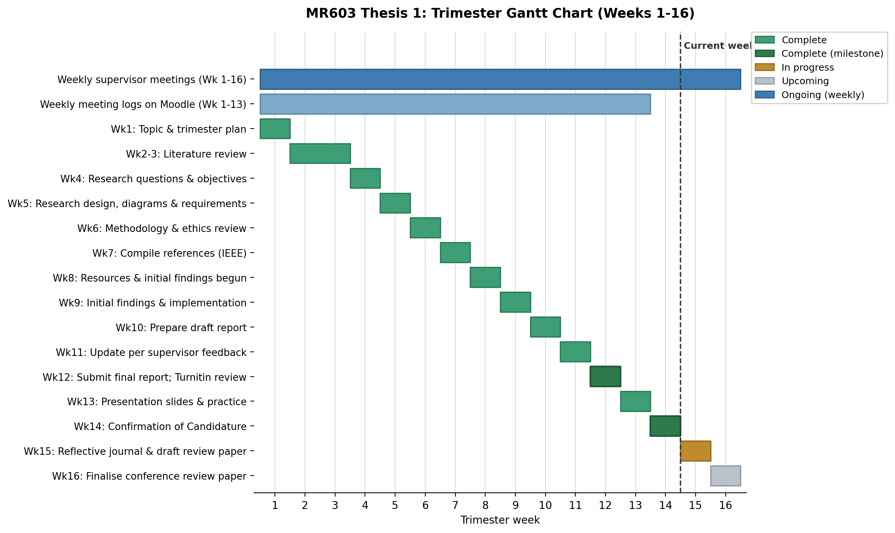
Timeline (Gantt Chart)
MR603 established feasibility; MR604 completes the comparative study
Figure 2. MR603 trimester Gantt chart, weeks 1-16
Sources: timeline aligned with the MR603 weekly roadmap
Notes:
[~30 sec] This is my timeline. MR603 established feasibility: the literature, the methodology and these three tests. The full comparison across all methods and datasets continues in MR604.

Slide 17
Limitations, Future Work, and Publication Plan
Each limitation maps to a concrete next step; publication depends on the evidence
LIMITATION
NEXT STEP
Fixed synthetic source
Vary source location across cases
PUBLICATION PLAN
A comparative diagnostic study
A
Prevents an 'always Pump' shortcut
One SMD machine
Extend to additional machines
A propagation-aware benchmark
B
Tests whether findings generalise
SWaT / MSDS not yet integrated
Complete access, preprocessing and event alignment
A new propagation-aware method, only if a reproducible limitation remains
C
Adds realistic industrial evidence
AERCA only checked on its own system
Run causal and non-causal methods on shared settings
No novelty for its own sake: every claim needs task-appropriate ground truth and reproducible evidence.
Gives a fair causal vs non-causal comparison
Sources: limitations and future-work plan; publication plan, Section 10 of the report
Notes:
[~45 sec] Each limitation maps to a next step. The synthetic source is always the pump, so I will vary the source location. I used one SMD machine, so I will add more machines. SWaT and MSDS are not yet integrated, so I will complete access and preprocessing. And AERCA was only checked on its own system, so I will run causal and non-causal methods on the same settings.
For publication there are three possible outcomes; a new method is only one of them.

Slide 18
Conclusion
Preliminary findings from three small tests
1
Symptoms can mislead
2
Simple ranking falls short
In a controlled test, the most abnormal sensor was not where the fault started.
Picking the "biggest" or "earliest" anomaly often points to the wrong sensor.
3
Data preparation matters
4
AERCA runs correctly
Small preprocessing choices can change which sensor is blamed.
It worked on its own test system; independent testing is next.
Next: compare all methods fairly on the same data, then decide if a new method is needed.
18
Notes:
[~40 sec] To conclude, these are preliminary findings from three small tests.
First, symptoms can outrank the source: in a controlled test, the most abnormal sensor was not where the fault started.
Second, simple ranking falls short: the biggest change found the pump zero out of thirty times.
Third, data preparation matters: one preprocessing choice changed the SMD result from 5 out of 8 to 8 out of 8.
Fourth, AERCA runs correctly on its own system, and independent testing is next.
Next, I will compare all methods fairly on the same data, and only then decide whether a new method is needed.

Slide 19
References
Key sources cited in this presentation (IEEE style)
[1] Y. Su et al., "Robust anomaly detection for multivariate time series through stochastic recurrent neural network," ACM SIGKDD, 2019.
[2] A. Deng and B. Hooi, "Graph neural network-based anomaly detection in multivariate time series," AAAI, 2021.
[3] J. Xu et al., "Anomaly Transformer: Time series anomaly detection with association discrepancy," ICLR, 2022.
[4] C. Zhang et al., "A deep neural network for unsupervised anomaly detection and diagnosis in multivariate time series data," AAAI, 2019.
[5] Z. Li et al., "Multivariate time series anomaly detection and interpretation using hierarchical inter-metric and temporal embedding," ACM SIGKDD, 2021.
[6] H. Zhao et al., "Multivariate time-series anomaly detection via graph attention network," IEEE ICDM, 2020.
[7] Z. Dai et al., "SARAD: Spatial association-aware anomaly detection and diagnosis for multivariate time series," NeurIPS, 2024.
[8] C. Shimillas et al., "Low rank transformer for multivariate time series anomaly detection and localization," ICLR, 2026.
[9] K. Budhathoki et al., "Causal structure-based root cause analysis of outliers," ICML, 2022.
[10] M. Li et al., "Causal inference-based root cause analysis for online service systems with intervention recognition," ACM SIGKDD, 2022.
[11] A. Ikram et al., "Root cause analysis of failures in microservices through causal discovery," NeurIPS, 2022.
[12] X. Han et al., "Root cause analysis of anomalies in multivariate time series through Granger causal discovery," ICLR, 2025.
[13] S. Kim et al., "Towards a rigorous evaluation of time-series anomaly detection," AAAI, 2022.
[14] Q. Liu and J. Paparrizos, "The elephant in the room: Towards a reliable time-series anomaly detection benchmark," NeurIPS, 2024.
[15] X. Qiu et al., "TAB: Unified benchmarking of time series anomaly detection methods," PVLDB, 2025.
[16] X. Zhou et al., "mTSBench: Benchmarking multivariate time series anomaly detection and model selection at scale," TMLR, 2026.
[17] B. Zong et al., "Deep autoencoding Gaussian mixture model for unsupervised anomaly detection," ICLR, 2018.
[18] D. Li et al., "MAD-GAN: Multivariate anomaly detection for time series data with generative adversarial networks," ICANN, 2019.
[19] J. Audibert et al., "USAD: Unsupervised anomaly detection on multivariate time series," ACM SIGKDD, 2020.
[20] L. Shen et al., "Timeseries anomaly detection using temporal hierarchical one-class network," NeurIPS, 2020.
[21] S. Ray et al., "Learning graph neural networks for multivariate time series anomaly detection," arXiv:2111.08082, 2021.
[22] X. Chen et al., "DAEMON: Unsupervised anomaly detection and interpretation for multivariate time series," IEEE ICDE, 2021.
[23] A. Abdulaal et al., "Practical approach to asynchronous multivariate time series anomaly detection and localization," ACM SIGKDD, 2021.
[24] S. Tuli et al., "TranAD: Deep transformer networks for anomaly detection in multivariate time series data," PVLDB, 2022.
[25] Q. Zhou et al., "Detecting multivariate time series anomalies with zero known label," AAAI, 2023.
[26] J. Song et al., "MEMTO: Memory-guided transformer for multivariate time series anomaly detection," NeurIPS, 2023.
[27] C. Shimillas et al., "Transformer-based multivariate time series anomaly localization," IEEE CIE/CPS, 2025.
[28] D. Cho et al., "Structured temporal causality for interpretable multivariate time series anomaly detection," NeurIPS, 2025.
[29] X. Sun et al., "State-derivative-aware neural controlled differential equations for multivariate time series anomaly detection and diagnosis," AAAI, 2026.
[30] C. K. Assaad et al., "Root cause identification for collective anomalies in time series given an acyclic summary causal graph with loops," AISTATS, 2023.
[31] D. Wang et al., "Incremental causal graph learning for online root cause analysis," ACM SIGKDD, 2023.
[32] C. Feng et al., "Root cause localization for wind turbines using physics guided multivariate graphical modeling and fault propagation analysis," Knowledge-Based Systems, 2024.
[33] H. Kim et al., "Causality-aware contrastive learning for robust multivariate time-series anomaly detection," ICML, 2025.
[34] W. Kim et al., "Causal disentanglement learning for accurate anomaly detection in multivariate time series," arXiv:2510.11084, 2025.
[35] M. Wang et al., "Channel matters: Estimating channel influence for multivariate time series," NeurIPS, 2025.
[36] A. Hasan et al., "Root cause analysis of anomalies in 5G RAN using graph neural network and transformer," arXiv:2406.15638, 2024.
[37] S. Mishra et al., "Conditional attribution for root cause analysis in time-series anomaly detection," arXiv:2604.17616, 2026.
[38] J. Goh et al., "A dataset to support research in the design of secure water treatment systems," CIIS, 2017.
[39] S. Nedelkoski et al., "Multi-source distributed system data for AI-powered analytics," ESOCC, 2020.
Notes:
[Do not present] Leave this slide available in case an examiner asks about a specific reference.

Slide 20
Q&A
Thank you
Syeda Tamanna Sheme | MIT251762
Notes:
Thank you. I am happy to take any questions.

